Slide 1
Programming Fundamentals
By
Shazmeen Batool

Slide 2
Previous Lecture
Introduction to File Handling

Slide 3
Today’s Lecture
File Stream Objects
Setting Up a Program for File Input/Output
Creating a File Object and Opening a File
Closing a File
Writing Data to a File

Slide 4
File Stream Objects
In order for a program to work with a file on the computer’s disk, the program must create a file stream object in memory.
A file stream object is an object that is associated with a specific file and provides a way for the program to work with that file.
It is called a “stream” object because a file can be thought of as a stream of data.

Slide 5
File Stream Objects
File stream objects work very much like the cin and cout objects. A stream of data may be sent to cout, which causes values to be displayed on the screen. A stream of data may be read from the keyboard by cin, and stored in variables.
Likewise, streams of data may be sent to a file stream object, which writes the data to a file. When data is read from a file, the data flows from the file stream object that is associated with the file, into variables.

Slide 6
Setting Up a Program for File Input/Output
Just as cin and cout require the iostream file to be included in the program, C++ file access requires another header file.
The file fstream contains all the declarations necessary for file operations. It is included with the following statement:

Slide 7
Setting Up a Program for File Input/Output
The fstream header file defines the data types ofstream, ifstream, and fstream.
Before a C++ program can work with a file, it must define an object of one of these data types.
The object will be “linked” with an actual file on the computer’s disk, and the operations that may be performed on the file depend on which of these three data types you pick for the file stream object.

Slide 8
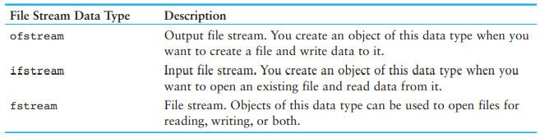
Setting Up a Program for File Input/Output

Slide 9
Creating a File Object and Opening a File
Before data can be written to or read from a file, the following things must happen:
A file stream object must be created.
The file must be opened and linked to the file stream object

Slide 10

Creating a File Object and Opening a File
The following code shows an example of opening a file for input (reading).
After this code executes, you will be able to use the inputFile object to read data from the Customers.txt file.

Slide 11

Creating a File Object and Opening a File
The following code shows an example of opening a file for output (writing).
After this code executes, you will be able to use the outputFile object to write data to the Employees.txt file.

Slide 12
Creating a File Object and Opening a File
It’s important to remember that when you call an ofstream object’s open member function, the specified file will be created.
If the specified file already exists, it will be erased, and a new file with the same name will be created.

Slide 13
Creating a File Object and Opening a File
Often, when opening a file, you will need to specify its path as well as its name. For example, on a Windows system the following statement opens the file C:\data\inventory.txt :
Notice the use of two backslashes in the file’s path. Two backslashes are needed to represent one backslash in a string literal.
In this statement, the file C:\data\inventory.txt is opened and linked with inputFile.

Slide 14
Creating a File Object and Opening a File
It is possible to define a file stream object and open a file in one statement. Here is an example:
This statement defines an ifstream object named inputFile and opens the Customer.txt file. Here is an example that defines an ofstream object named outputFile and opens the Employees.txt file:

Slide 15
Closing a File
The opposite of opening a file is closing it. Although a program’s files are automatically closed when the program shuts down, it is a good programming practice to write statements that close them.
Here are two reasons a program should close files when it is finished using them:
Some operating systems limit the number of files that may be open at one time. When a program closes files that are no longer being used, it will not deplete more of the operating system’s resources than necessary.

Slide 16
Closing a File
Most operating systems temporarily store data in a file buffer before it is written to a file. A file buffer is a small “holding section” of memory that file-bound data is first written to. When the buffer is filled, all the data stored there is written to the file. This technique improves the system’s performance. Closing a file causes any unsaved data that may still be held in a buffer to be saved to its file. This means the data will be in the file if you need to read it later in the same program.

Slide 17
Closing a File
Calling the file stream object’s close member function closes a file. Here is an example:

Slide 18
Writing Data to a File
You already know how to use the stream insertion operator (<<) with the cout object to write data to the screen.
It can also be used with ofstream objects to write data to a file.
Assuming outputFile is an ofstream object, the following statement demonstrates using the << operator to write a string literal to a file:

Slide 19
Writing Data to a File
This statement writes the string literal "I love C++ programming\n" to the file associated with outputFile.
As you can see, the statement looks like a cout statement, except the name of the ofstream object name replaces cout.
Here is a statement that writes both a string literal and the contents of a variable to a file:

Slide 20
Writing Data to a File
The statement above writes the stream of data to outputFile exactly as cout would write it to the screen: It writes the string "Price: ", followed by the value of the price variable, followed by a newline character.

Slide 21
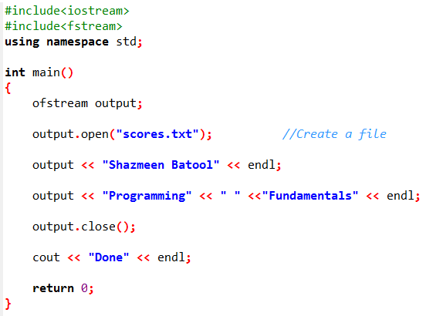
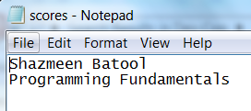


Slide 22
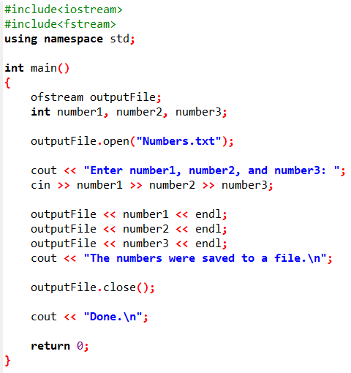
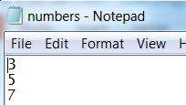
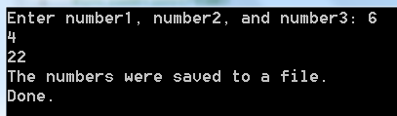
Example

Slide 23
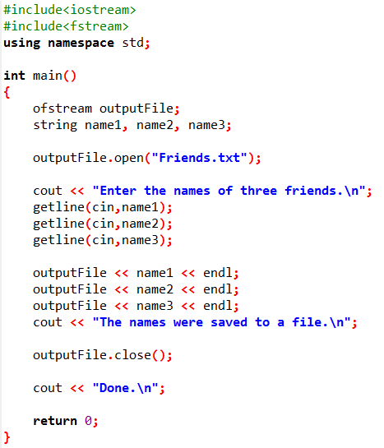

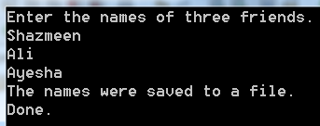
Example

Slide 24
Next Lecture
Reading Data from a File
The Read Position
Reading Numeric Data From a Text File
Using Loops to Process Files
Detecting the End of the File
Testing for File Open Errors
Letting the User Specify a Filename

